Slide 1
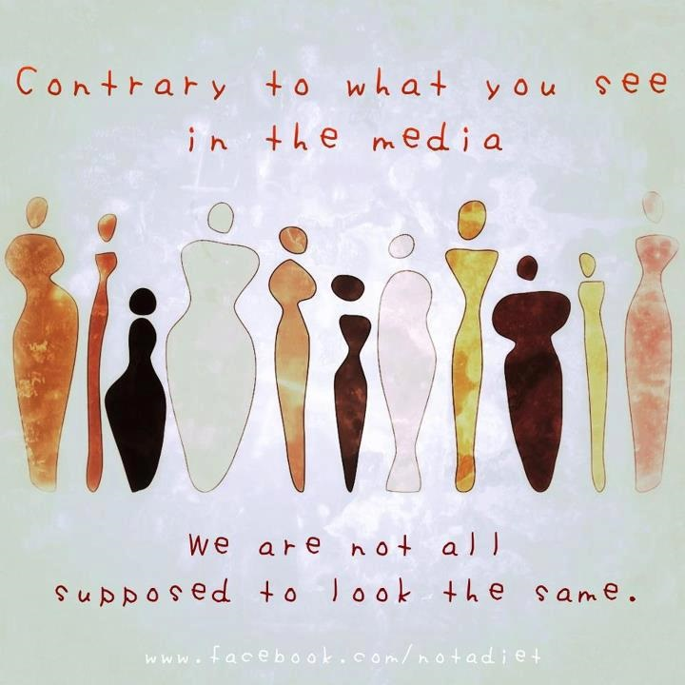
BODY IMAGES

Slide 2
“Body image ” These are two words that have recently become commonplace in the media, whether they are used positively…or negatively. When you put the words together, what do they really mean? Do they conjure feelings of security, love, and value, or do they inflict feelings of shame and a desire to alter oneself?

Slide 3
Body image is the perception that a person has of their physical self and the thoughts and feelings that result from that perception. These feelings can be positive, negative or both, and are influenced by individual and environmental factors. Body image is determined by 4 factors:

Slide 4
1. How you SEE your body is your perceptual body image. This is not always a correct representation of how you actually look. For example, a person may perceive themselves as overweight when they are actually underweight.

Slide 5
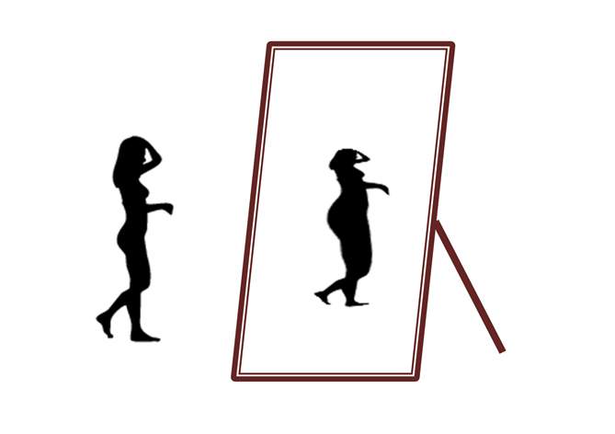

Slide 6
2. The way you feel about your body is your affective body image. This relates to the amount of satisfaction or dissatisfaction you feel about your shape, weight, and individual body parts.

Slide 7
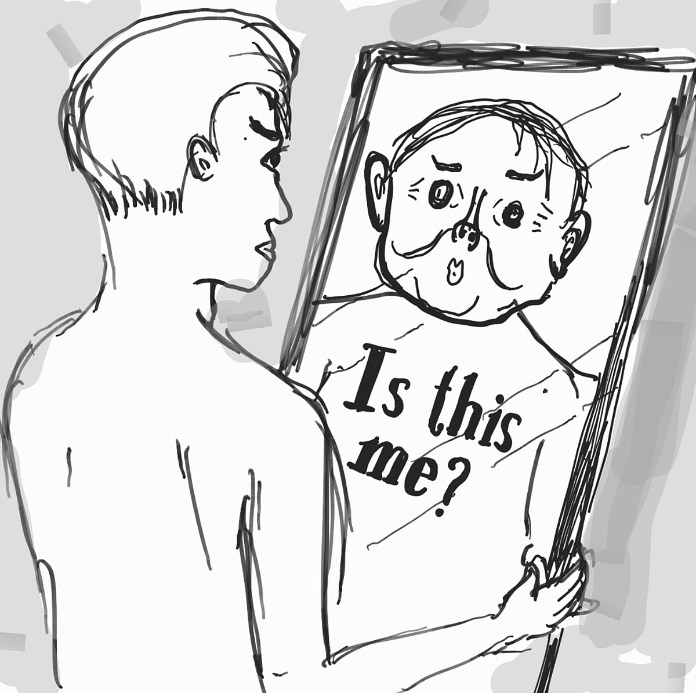

Slide 8
3. The way you THINK about your body is your cognitive body image. This can lead to preoccupation with body shape and weight.

Slide 9
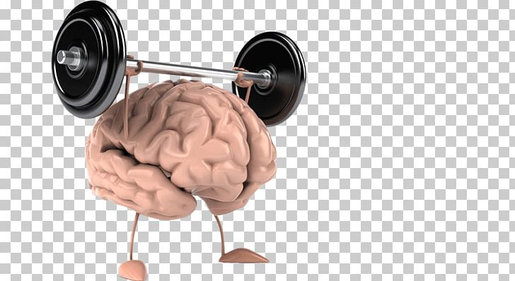

Slide 10
4. Behaviors in which you engage as a result of your body image encompass your behavioural body image. When a person is dissatisfied with the way he/she looks, they may isolate themselves because they feel bad about their appearance.

Slide 11
People with negative body image are more likely to suffer from feelings of depression, isolation, low self-esteem, & obsessions with weight loss.

Slide 12
We all may have our days when we feel awkward or uncomfortable in our bodies, but the key to developing positive body image is to recognize and respect our natural shape and learn to overpower those negative thoughts and feelings with positive, affirming, and accepting ones.

Slide 13
Key points
Healthy body image is feeling happy and satisfied with your body.
Help your child develop healthy body image by talking, focusing on your child as a whole person, and being a positive role model.
Signs of unhealthy body image include your child being self-critical, comparing his body to others, obsessing about weight loss and so on.
Speak to a health professional if you’re concerned about your child’s body image.

Slide 14
The ımpact of medıa on people’s food choıce

Slide 15
Mass media which includes radio, television,
newspapers,magazines and internet is a great source of information for the society. Every day we are bombarded with images that come out of the television, magazines or the internet.

Slide 16
ADVERTISING
Advertising is the primary source of income for the media. Through advertising, we see several messages on a daily basis.

Slide 18
Millions of dollars are spent by manufacturers in order to make their advertisements attractive. Techniques like attractive jingles, catchy phrases and attractive photography are employed to create an illusory world where the food item that is being marketed will seem irresistible.

Slide 19
Children and adolescents spend a considerable amount of time watching television. As a result, youth are exposed to
a large number of food and beverage advertisements each day.

Slide 20
The media is a strong social influence on the food choices.People may choose to prepare foods in a way shown on TV or blogs or instagram.They may choose to buy foods reported to have certain health benefits.Researches show that children view in excess o n 22 000 commercials in a year.They become socialized to want the foods they see advertised.

Slide 22
Family communication and media education is an important component in mediating the negative effects of advertising on children’s dietary behaviours.

Slide 23
It is important that parents be
aware of the amount of advertising exposure their children receive and its impact on their food preferences. Parents should also understand the importance of refraining from watching TV during meals, removing TV from children’s bedrooms, and generally limiting their children’s exposure to TV and internet.

Slide 24
SCHOOL CAFETERIA AND HEALTY DIETARY GUIDELINES

Slide 25
The functions of school canteens are to:
provide a service to the school community.
provide a variety of nutritious and attractively presented food and drinks at a reasonable cost

Slide 26
School canteens are an integral part of school life. They are a lifesaver for busy parents running out the door with multiple drop-offs, a work day to negotiate and no lunchbox food in the house. For kids, it is a chance to independently manage their own food choices for the first time. School canteens also underpin all the healthy eating education that goes on during class time.

Slide 27
School cafeteria or
canteen food Guidelines
Main meal must comprise food
belonging to the 4 main food groups.
Carbohydrates (eg. brown rice and
wholemeal bread)
Protein
Fruit (at least ½ serving)
Vegetables (at least 2 heaped dessert
spoons)

Slide 28
2. Whole grains must be included.
Rice: Include at least 20% of unpolished rice (eg. brown rice)
Noodles: Include at least 20% of
wholemeal/wholegrain option
Bread: Use only wholemeal/wholegrain
bread

Slide 29
3. Use only skinless poultry and lean

Slide 30
4. No selling of deep-fried food
(including food that have been pre-fried
and
preserved food
(eg.sausages containing nitrites,
luncheon meat, preserved vegatables)

Slide 31
5. Replace half or more of high-fat ingredients with
reduced-fat alternatives (eg. mayonnaise with reduced-
fat
Use only oils with the Healthier Choice symbol.

Slide 32
6. Serve gravy/sauce only upon request. Upon request,
serve only up to dessert spoons of gravy/sauce.

Slide 33
7. Sell only drinks with less than 6g of
sugar per 100ml.
All drinks sweetened with intense
sweeteners (eg.aspartame)are not to be
Sold.

