Slide 1
EATING BEHAVIOUR AND OBESITY
Nutrtionist and Dietitian Billur Filiz

Slide 2
According to WHO; Obesity is defined as abnormal or excessive fat accumulation that presents a risk to health.
Overweight and obesity are major risk factors for a number of chronic diseases, including diabetes, cardiovascular diseases and cancer.

Slide 3
Excessive Energy Consumption
Inadequate Energy Expending
OBESITY
Life Style
Behavior Pattern
Genetic Factors
Socio-economic Status
ENERGY BALANCE

Slide 4
Body mass index (BMI) is a simple index of weight-for-height that is commonly used to classify overweight and obesity in adults. It is defined as a person's weight in kilograms divided by the square of his height in meters (kg/m²).

Slide 5
Adults
For adults, WHO defines overweight and obesity as follows:
overweight is a BMI greater than or equal to 25; and
obesity is a BMI greater than or equal to 30.

Slide 6
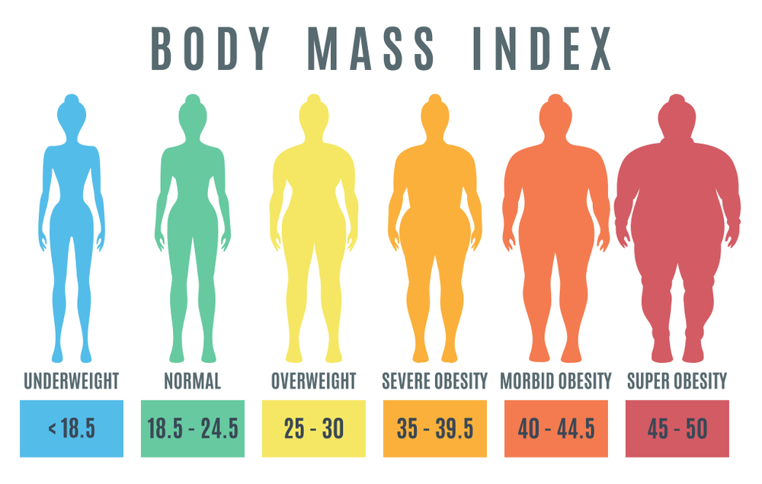
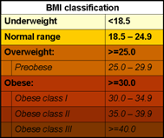

Slide 7
BMI provides the most useful population-level measure of overweight and obesity as it is the same for both sexes and for all ages of adults.
However, it should be considered a rough guide because it may not correspond to the same degree of fatness in different individuals.
If fat mass is over than %25 in men and %35 in women that consider as obesity.

Slide 8
For children, age and gender needs to be considered when defining overweight and obesity.
Growth charts or Percentile Charts are used to evaluate for childhood obesity. According to percentile charts, 85 percentil and over that means overweight, 97 percentil and over that means obese.

Slide 9
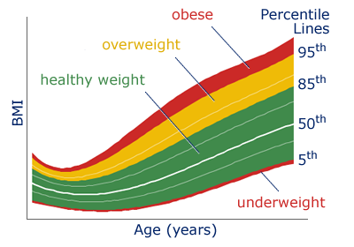

Slide 11
Obesity In Worldwide
Some recent WHO global estimates follow.
In 2016, more than 1.9 billion adults aged 18 years and older were overweight. Of these over 650 million adults were obese.
In 2016, 39% of adults aged 18 years and over (39% of men and 40% of women) were overweight.
Overall, about 13% of the world’s adult population (11% of men and 15% of women) were obese in 2016.
The worldwide prevalence of obesity nearly tripled between 1975 and 2016.

Slide 12
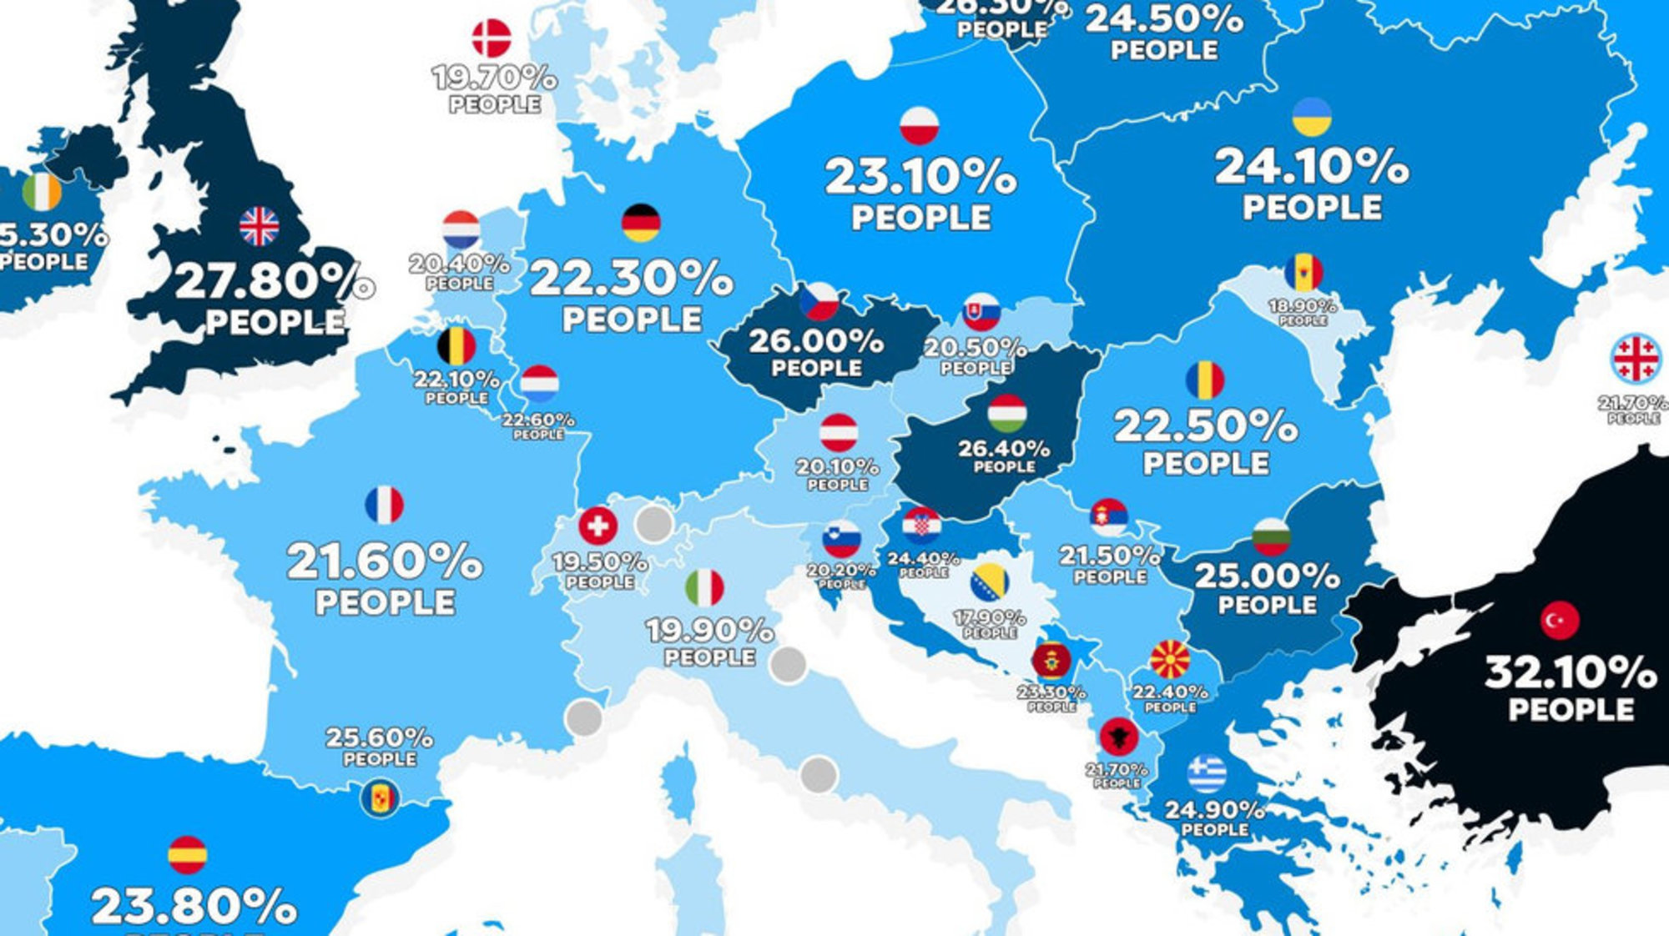

Slide 13
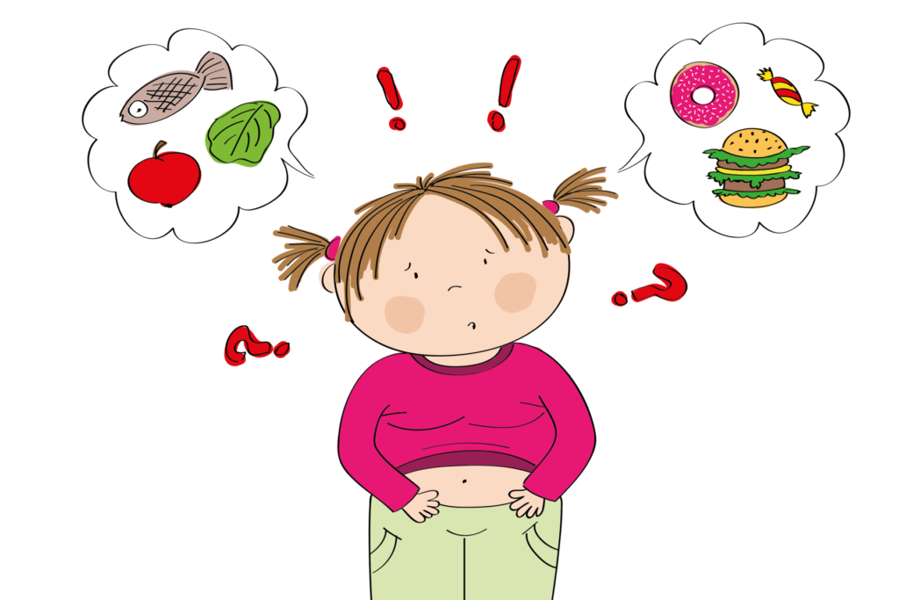
Childhood obesity is one of the most serious public health challenges of the 21st century. The problem is global and is steadily affecting many low- and middle-income countries, particularly in urban settings. The prevalence has increased at an alarming rate.
Globally, in 2016 the number of overweight children under the age of five, is estimated to be over 41 million. Almost half of all overweight children under 5 lived in Asia and one quarter lived in Africa.

Slide 14
Over 340 million children and adolescents aged 5-19 were overweight or obese in 2016.
The prevalence of overweight and obesity among children and adolescents aged 5-19 has risen dramatically from just 4% in 1975 to just over 18% in 2016. The rise has occurred similarly among both boys and girls: in 2016 18% of girls and 19% of boys were overweight.

Slide 15
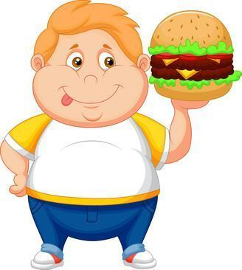
Overweight and obese children are likely to stay obese into adulthood and more likely to develop noncommunicable diseases like diabetes and cardiovascular diseases at a younger age. Overweight and obesity, as well as their related diseases, are largely preventable. Prevention of childhood obesity therefore needs high priority.

Slide 16
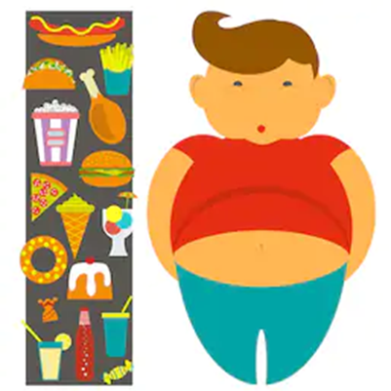
According to European Congress on Obesity (ECO)’s data, %30-70 of adults ara overweight and %10-30 of adults are obese. ECO says in europe one fifth of childeren are overweght and one third of childeren are obese.

Slide 17
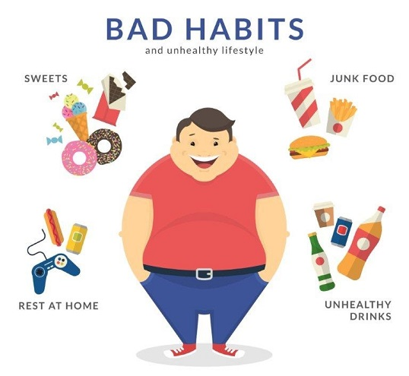
Childhood Obesity Surveillance Initiative ( COSI-TUR) search conduct in second class childeren of primery schools in Turkey and according to results of 2016, %14.6 of childeren are overweight and %9.9 are obese.

Slide 18
Obesity Prevelance of Baki Gündüz Primary School
CLASSES | NORMAL RANGE | OVERWEIGHT | OBESE
First Classes | 163 | 18 | 5
Second Classes | 119 | 26 | 3

Slide 19
Reasons of Obesity
The fundamental cause of obesity and overweight is an energy imbalance between calories consumed and calories expended. Globally, there has been:
an increased intake of energy-dense foods that are high in fat; and
an increase in physical inactivity due to the increasingly sedentary nature of many forms of work, changing modes of transportation, and increasing urbanization.
Changes in dietary and physical activity patterns are often the result of environmental and societal changes associated with development and lack of supportive policies in sectors such as health, agriculture, transport, urban planning, environment, food processing, distribution, marketing, and education.

Slide 20
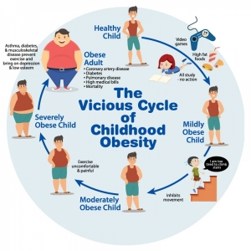
Also skipping meal especially breakfast is one of the proven reason of obesity.
According to studies if both parents are obese that increase the risk of obesity in childhood.

Slide 21
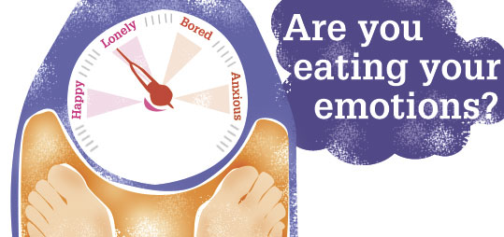
EATING BEHAVIOUR
There are three types of behavior causing obesity:
Emotional Eating
Inhibitive Eating
External Eating

Slide 22
Emotional Eating
Bored
Lonely
Being in emptiness
Anger
Rage
Irritation
Lightening
Reactional
Overeating situation, although they’re not hungry.

Slide 23
Inhibitive Eating
Being on DIET
Inhibiting Energy and Nutrition
Purpose is losing or controling weight
Increase Energy and Nutrition
Getting Fat
NORMAL RANGE
OVERWEIGHT

Slide 24
External Eating
FLAVOUR
SMELL
IMAGE
Depending on these factors overeating situation only food existing

Slide 25
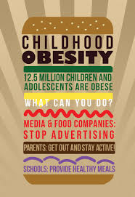
Children’s eating patterns and food selections occur in first two years of their lives.
According to an UNICEF study, these patterns and selections take form from parents’ eating behaviour and habits.

Slide 26
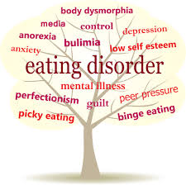
Eating Disorders
In eating disorders, individuals have harmful eating habits to protect or loose their wieght. They aim to be ‘’much thiner’’ and beacuse of that they ‘re overreacted about foods and exercise.
There are three risk factors cause any eating disorder:
Individual,
Familiare,
Sociocultural factors.

Slide 27
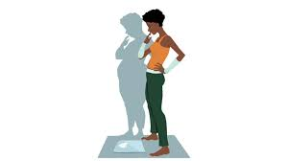
Anorexia Nervosa:
Symptoms:
-possessiveness to thiner body
-anxious about overweighting
-disorder about body image
-amenore

Slide 28
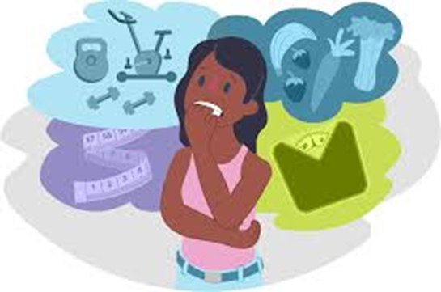
Patients are inhibing food intake extremly and exercising intensivley. Also they can use some laxatives and diuretics to avoid getting more calories. In this case patient atrophied thus threatining their health.

Slide 29
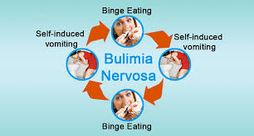
Bulimia nervosa:
There are over-eating attacs in bulimia. Patients eat too much and than make themselves vomit. In blumia, patients are owerweight or normal range unlike anorexia.

Slide 30
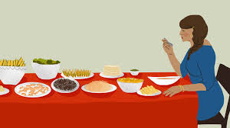
Binge eating disorder:
Binge eating disorder is characterized by frequent and persistent overeating episodesthat are accompanied by feeling of loss of control overeating without regular compensatory behaviours.
It’s seeing %3.5 of women, %2 of men and %1.6 of teenagers.

Slide 31
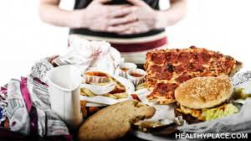
Difference between blumia and binge, in binge sendrome patients don’t vomit or use laxatives and diuretics.
Patients are typically overeating periodically for two hours and loosing their control during this time. These people eat fast and prefer being alone while they’re eating. Mostly of them are obese.

Slide 32
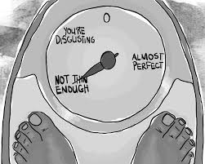
As a conclusion, having utility eating habits and behaviours can preverse from obesity and eating disorders such as anorexia or blumia nervosa.
And there are some roles of schools to protect to childeren from these disease.

Slide 33
World Health Organization’s suggestions about role of school are as follows:
Suggestions to promote healthy diets in schools
provide health education to help students acquire knowledge, attitudes, beliefs and skills which are needed to make informed decisions, practice healthy behaviours and create conditions that are conducive to health;
provide school food programmes to increase the availability of healthy food in schools (e.g. breakfast, lunch and/or snacks at reduced price);

Slide 34
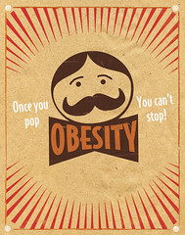
have vending machines only if they sell healthy options like water, milks, juices, fruits and vegetables, sandwiches and low-fat snacks;
ensure that food served in schools adheres to minimum nutrition standards;
provide school health services for students and staff of the school to help foster health and well-being as well as prevent, reduce, monitor, treat and refer important health problems or conditions for students and staff of the school;
use school gardens as a tool to develop awareness about food origins;
promote parental involvement.

Slide 35
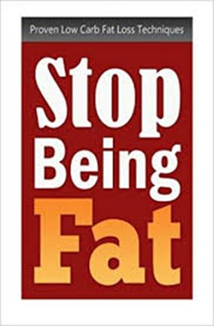
Suggestions to promote physical activity in schools
offer daily physical education classes with a variety of activities, so that the maximum number of students' needs, interests and abilities are addressed;
offer extracurricular activities: school sports and non-competitive school programmes (e.g. active recess);

Slide 36
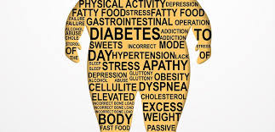
encourage safe, non-motorized modes of transportation to school and other social activities;
provide access to adequate physical activity facilities to students and the community;
encourage students, teachers, parents and the community to become physically active.

Slide 37
THANKS FOR LISTENING…

